Slide 1

BACHELOR OF TECHNOLOGY
IN
Artificial Intelligence and Machine Learning
Gesture prediction
Project Guide: Dr. S. Ramesh kumar
Department of AIML, School of Engineering
Malla Reddy University
Batch Members: Roll Numbers:
D. Sahithya Chowdary 2011CS020098
E. Moukthika 2011CS020112
E. Sai Vatsalya 2011CS020113
G. Jyothi Sree 2011CS020129

Slide 2
CONTENTS
Abstract
Problem Statement
Introduction
Literature Survey
Research Gap
Block Diagram/Architecture
Algorithms/Flow Charts
Results
Conclusion

Slide 3
ABSTRACT
Gesture recognition using deep learning has emerged as a promising approach for enhancing human-computer interaction across various domains. This paper presents an in-depth exploration of the challenges and solutions involved in developing predictive models for gesture recognition using deep learning techniques. We discuss the importance of data representation, model architecture, training data diversity, real-time inference, and generalization in achieving accurate and robust gesture recognition systems. Leveraging deep neural networks, our research aims to design a system capable of efficiently learning complex spatiotemporal patterns from raw sensor inputs, enabling real-time recognition of diverse hand gestures in various environmental conditions. By addressing these challenges, our work seeks to advance the field of gesture recognition and contribute to the development of more natural and intuitive human-computer interaction paradigms.

Slide 4
PROBLEM STATEMENT
Despite significant advancements in gesture recognition systems, there remain challenges in accurately predicting and interpreting complex hand gestures in real-time. Traditional approaches often rely on handcrafted features and shallow learning algorithms, limiting their ability to capture intricate patterns and variations in gestures. Moreover, these methods struggle with robustness in different environmental conditions, variations in lighting, and occlusions. Despite advancements in gesture recognition technology, accurately identifying and categorizing dynamic gestures remains problematic due to motion variability, and obstructions.

Slide 5
INTRODUCTION
Gesture recognition has emerged as a crucial component in human-computer interaction systems, enabling natural and intuitive communication between users and machines.
Dynamic gesture recognition, in particular, focuses on interpreting gestures that involve motion, making it applicable in various domains such as sign language interpretation.
Deep learning techniques, especially Convolutional Neural Networks (CNNs), have shown remarkable performance in image recognition tasks. When combined with computer vision libraries like OpenCV, these techniques offer a robust framework for dynamic gesture recognition.
It explores the implementation and effectiveness of a dynamic gesture recognition system based on a 2D CNN architecture and OpenCV.

Slide 6
LITERATURE SURVEY
This work introduces a benchmark dataset for first-person hand action recognition, providing annotated RGB-D videos and 3D hand pose annotations, which facilitates benchmarking and evaluation of gesture recognition algorithms.
The authors propose a global context-aware attention LSTM network for 3D action recognition, which effectively incorporates global contextual information into the recognition process. This method improves the robustness of action recognition models, which can be beneficial for recognizing dynamic hand gestures.
The authors propose a real-time continuous gesture recognition system based on dynamic time warping using depth data, offering insights into efficient algorithms for recognizing continuous hand gestures.

Slide 7
RESEARCH GAP
Many existing deep learning models for gesture recognition are computationally intensive, limiting their deployment on resource-constrained devices or embedded systems. Research focusing on optimizing models for real-time performance on low-power devices remains sparse.
Existing datasets and models may not generalize well across diverse user demographics, including hand size and cultural backgrounds. Research is needed to develop more inclusive datasets and models that can effectively recognize gestures performed by users with diverse characteristics.
Gesture recognition systems may encounter scenarios where new gestures need to be added or existing gestures need to be updated over time. Investigating techniques for incremental and adaptive learning in deep learning models could enable them to continuously improve and adapt to changing gesture recognition requirements.
.

Slide 8
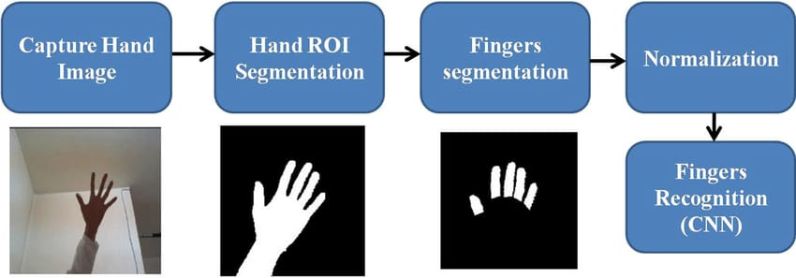
ARCHITECTURE

Slide 9
ALGORITHM:
CNNs are widely used for processing visual data such as RGB images or depth maps in gesture recognition systems. They excel at capturing spatial features and patterns, making them suitable for tasks like hand pose estimation or static gesture recognition.
Convolutional Neural Networks (CNNs) are pivotal in gesture recognition, extracting spatial features from visual data like RGB images or depth maps. They achieve spatial invariance and hierarchical feature learning through convolutional and pooling layers, enabling accurate identification of gestures despite variations in hand positions.
Trained on large-scale datasets, CNNs benefit from transfer learning to initialize models, improving recognition performance. Data augmentation techniques enhance model robustness by diversifying training data, while interpretability methods aid in understanding network decisions. Optimizing CNN architectures ensures real-time performance for efficient inference, crucial for applications like human-computer interaction.

Slide 10
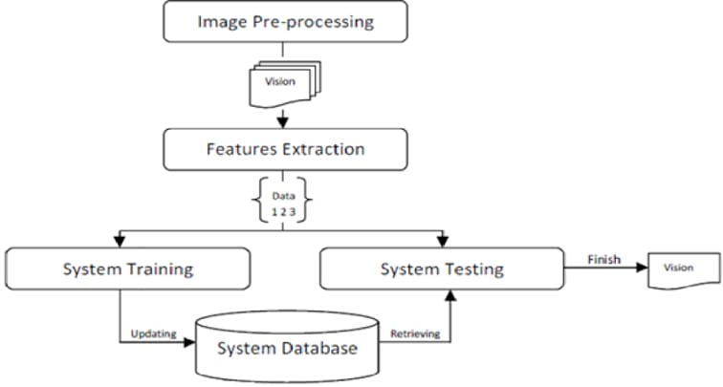
FLOWCHART:

Slide 11
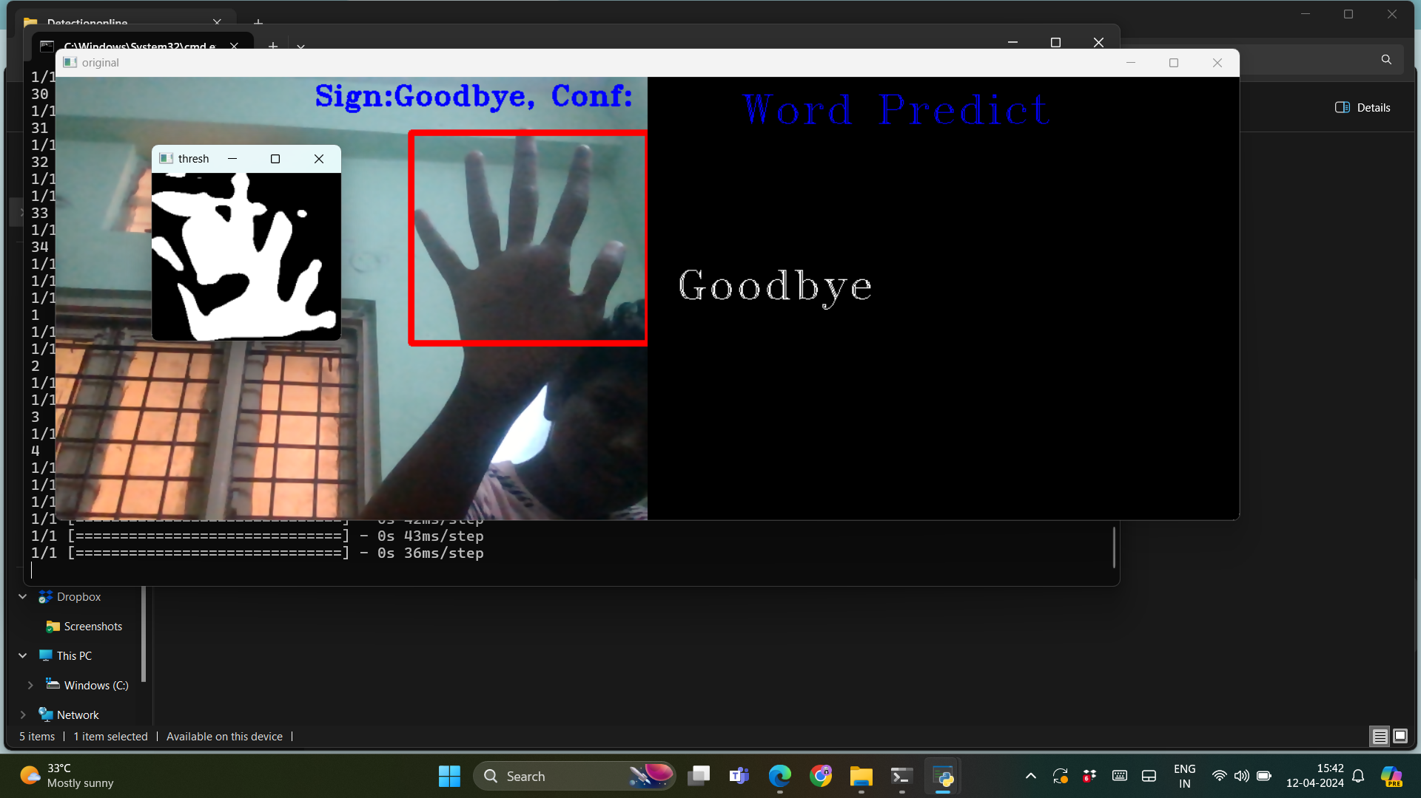
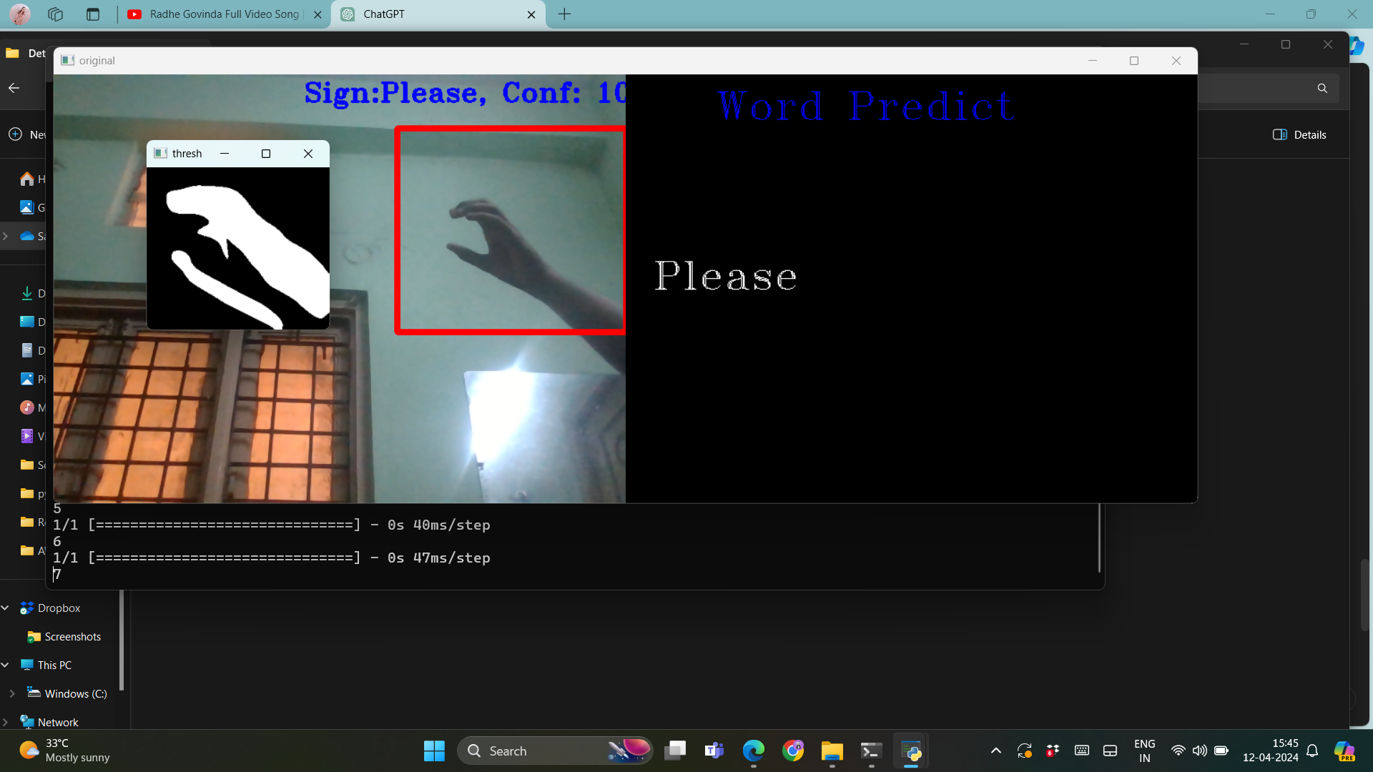
RESULTS:

Slide 12
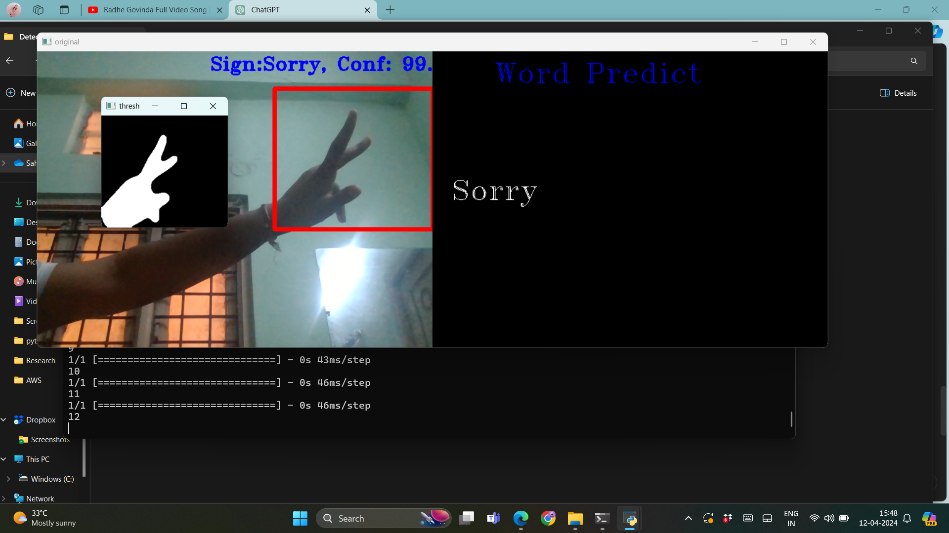
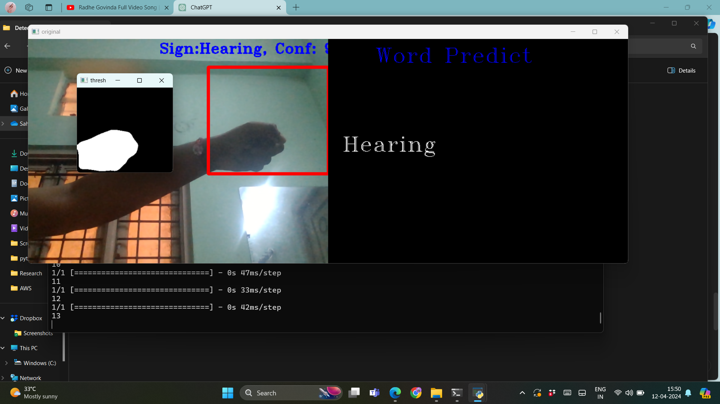

Slide 13
CONCLUSION
In conclusion, the utilization of deep learning techniques for gesture recognition heralds a transformative era in human-computer interaction. Through Convolutional Neural Networks (CNNs), and attention mechanisms, these systems adeptly capture spatial and temporal intricacies within gestures.
Robust training on diverse datasets and transfer learning strategies fortify their recognition prowess, while interpretability methods offer insights into model decision-making. Real-time inference optimization ensures seamless integration across applications.
As a result, deep learning-powered gesture recognition not only enhances user experience but also propels advancements in fields like gaming, virtual reality, robotics, and healthcare, heralding a future where intuitive human-machine interaction is the norm.

Slide 14
FUTURE SCOPE:
Further research can focus on improving the accuracy and robustness of gesture recognition systems by developing more sophisticated deep learning architectures, leveraging larger and more diverse datasets, and incorporating advanced techniques such as adversarial training and self-supervised learning.
Research can explore multimodal fusion techniques to integrate information from diverse sensor modalities such as visual, depth, and inertial sensors, along with contextual understanding of gestures within the broader context of user activities or environments.
Gesture recognition systems can evolve towards personalized and adaptive interfaces, capable of understanding individual user preferences, habits, and capabilities, and adapting their behavior accordingly. This could involve incorporating user feedback mechanisms and reinforcement learning techniques.

Slide 15
THANK YOU

